Slide 1
Reading Files

Slide 2
Opening a File
Before we can read the contents of the file we must tell Python which file we are going to work with and what we will be doing with the file
This is done with the open() function
open() returns a “file handle” - a variable used to perform operations on the file

Slide 3
Using open()
handle = open(filename, mode)
returns a handle use to manipulate the file
filename is a string
mode is optional and should be 'r' if we are planning reading the file and 'w' if we are going to write to the file.
fand = open('mbox.txt', 'r')

Slide 4
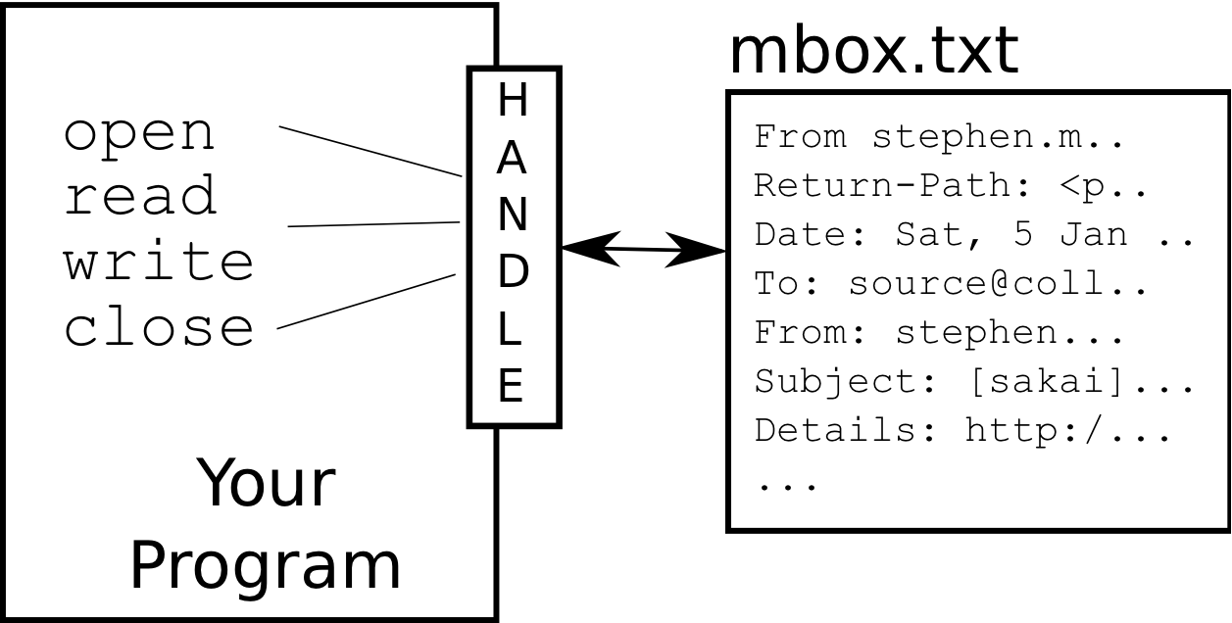
What is a File Handle?
>>> fhand = open('mbox.txt')
>>> print （fhand）
<open file 'mbox.txt', mode 'r' at 0x1005088b0>

Slide 5
When Files are Missing
>>> fhand = open('stuff.txt')
Traceback (most recent call last): File "<stdin>", line 1, in <module>
IOError: [Errno 2] No such file or directory: 'stuff.txt'

Slide 6
The newline Character
We use a special character to indicate when a line ends called the "newline"
We represent it as \n in strings
Newline is still one character - not two
>>> stuff = 'Hello\nWorld!'
>>> print stuff
Hello
World!
>>> stuff = 'X\nY'
>>> print stuff
X
Y
>>> len(stuff)
3

Slide 7

File Handle as a Sequence
A file handle open for read can be treated as a sequence of strings where each line in the file is a string in the sequence
xfile = open('mbox.txt')
for a in xfile:
print （a）

Slide 8
Counting Lines in a File
Open a file read-only
Use a for loop to read each line
Count the lines and print out the number of lines
fhand = open('mbox.txt')
count = 0
for line in fhand:
count = count + 1
print （'Line Count:', count）
Line Count: 132045

Slide 9
Reading the Whole File
We can read the whole file (newlines and all) into a single string.
>>> fhand = open('mbox-short.txt')
>>> inp = fhand.read()
>>> print （len(inp)）
94626
>>> print （inp[:20]）

Slide 10
Searching Through a File
fhand = open('mbox-short.txt')
for line in fhand:
if line.startswith('From:') :
print （line）
From: stephen.marquard@uct.ac.za
From: louis@media.berkeley.edu
From: zqian@umich.edu
From: rjlowe@iupui.edu...
We can put an if statement in our for loop to only print lines that meet some criteria

Slide 11
Searching Through a File (fixed)
We can strip the whitespace from the right hand side of the string using rstrip() from the string library
The newline is considered "white space" and is stripped
fhand = open('mbox-short.txt')
for line in fhand:
line = line.rstrip()
if line.startswith('From:') :
print （line）
From: stephen.marquard@uct.ac.za
From: louis@media.berkeley.edu
From: zqian@umich.edu
From: rjlowe@iupui.edu...

Slide 12
Skipping with continue
fhand = open('mbox-short.txt')
for line in fhand:
line = line.rstrip()
# Skip 'uninteresting lines'
if not line.startswith('From:') :
continue
# Process our 'interesting' line
print （line）
We can convienently skip a line by using the continue statement

Slide 13
Using in to select lines
We can look for a string anywhere in a line as our selection criteria
fhand = open('mbox-short.txt')
for line in fhand:
line = line.rstrip()
if not '@uct.ac.za' in line :
continue
print （line）

Slide 14
Prompt for File Name
fname = input('Enter the file name: ')
fhand = open(fname)
count = 0
for line in fhand:
if line.startswith('Subject:') :
count = count + 1
print （'There were', count, 'subject lines in', fname）
Enter the file name: mbox.txt
There were 1797 subject lines in mbox.txt

Slide 15
File Names
fname = raw_input('Enter the file name: ')
try:
fhand = open(fname)
except:
print （'File cannot be opened:', fname ）
exit()
count = 0
for line in fhand:
if line.startswith('Subject:') :
count = count + 1
print （'There were', count, 'subject lines in', fname）
Enter the file name: na
File cannot be opened: na

Slide 16
Summary
Secondary storage
Opening a file - file handle
The newline character in files
Reading a file line-by-line with a for loop
Reading the whole file as a string
Searching for lines
Stripping white space
Using continue
Using in as an operator
Reading a file and splitting lines
Prompting for file names
Dealing with bad files

